Slide 1
ISB-CGC BigQuery Table Search
Overview

Slide 2

ISB-CGC BigQuery Table Search
Overview

Slide 3
ISB-CGC BigQuery Table Search
Allows users to identify and learn more about available ISB-CGC BigQuery tables
No login required!
Each table has been curated to include detailed table and field descriptions as well as table labels
Search for table(s) of interest using a free-form text search or via available filters (including status, reference genome build, data format, category)
Explore table(s) of interest; learn about the data formats, data types and data sources
Preview first few ~10 lines of the table of interest

Slide 4
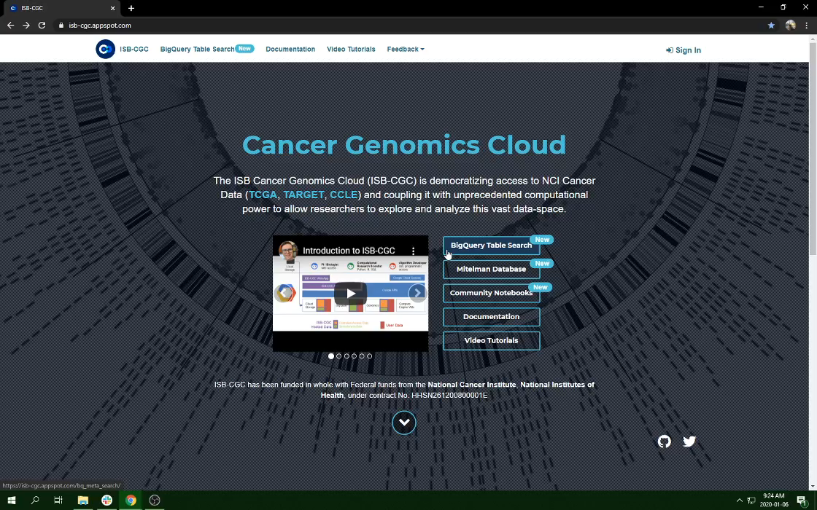
ISB-CGC BigQuery Table Search

